Slide 1


ITU - EACO
WORKSHOP ON EMERGING TECHNOLOGIES
SESSION 5
APPLICATIONS OF AI
WHAT IS MACHINE LEARNING

Slide 2
OBJECTIVES
PROVIDE KEYS TO NAVIGATE AI APPLICATIONS UNIVERSE
EXEMPLIFY STATE-OF-THE-ART AI APPLICATIONS
DEMYSTIFY AI TECHNICAL JARGON AND APPROACHES
GENERAL METHODOLOGY/PIPELINE

Slide 3
NAVIGATE AI APPLICATIONS
A FULL UNIVERSE

Slide 4

LIST AI APPLICATIONS YOU CAN THINK OF
HOW COULD YOU GROUP THEM?

Slide 5
BY “TECHNOLOGY“ TYPE
IMAGE RECOGNITION
OBJECT DETECTION
NATURAL LANGUAGE PROCESSING, SPEECH RECOGNITION
TIME SERIES PREDICTION
ROBOTIC
GAMES & SIMULATION

Slide 6
BY ACTIVITY SECTORS
HEALTH
AGRICULTURE, ENVIRONMENT
EDUCATION & SCIENCE
INDUSTRY
DEFENCE
FINANCE (ATS)
...

Slide 7
BUT MANY ARE TRANSECTORAL
TRANSPORTATION
LOGISTICS - Ex. of O2O (Online to Offline services)
ENERGY
VIRTUAL ASSISTANT
...

Slide 8
QUICK TOUR OF SOME AI
APPLICATIONS

Slide 9
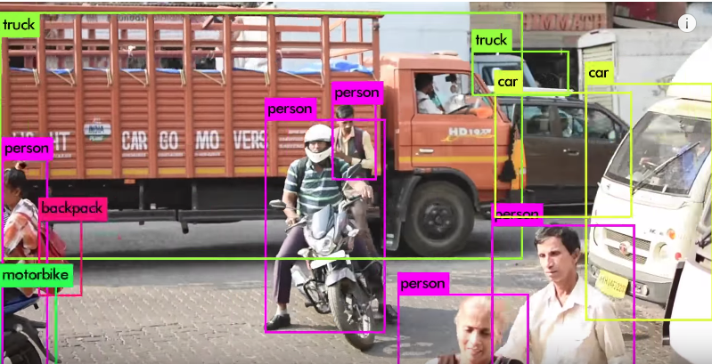
REAL TIME OBJECT DETECTION
https://pjreddie.com/darknet/yolo/

Slide 10
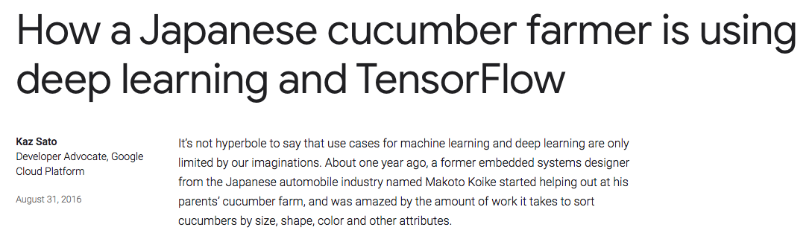
SMART FARMING
https://tinyurl.com/y7js7scm

Slide 11
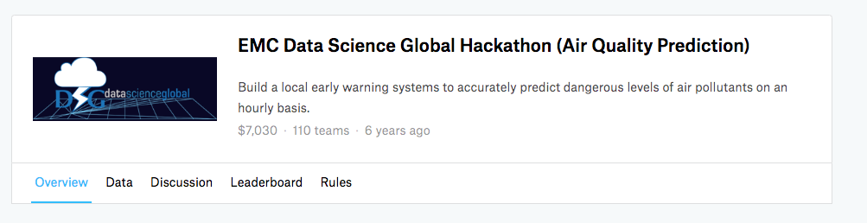
AIR QUALITY PREDICTION
https://www.kaggle.com/c/dsg-hackathon

Slide 12
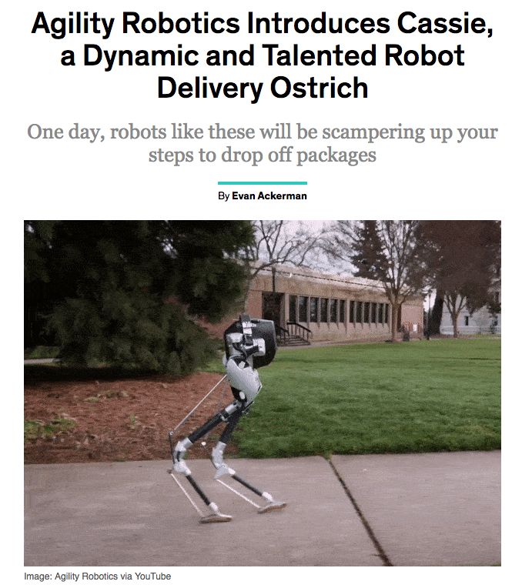
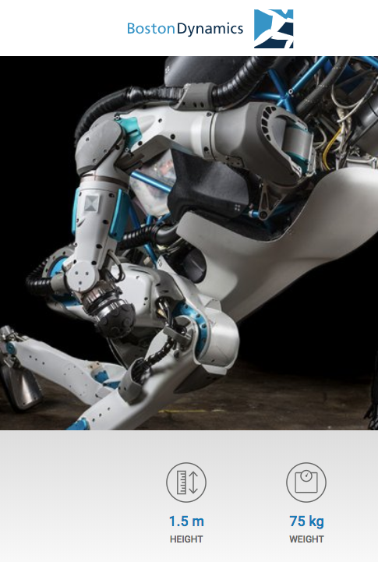
ROBOTICS
…
https://tinyurl.com/y7v433fs
https://www.bostondynamics.com/atlas
Notes:
But as well multi-agent, competitive, collaborative, mix

Slide 13
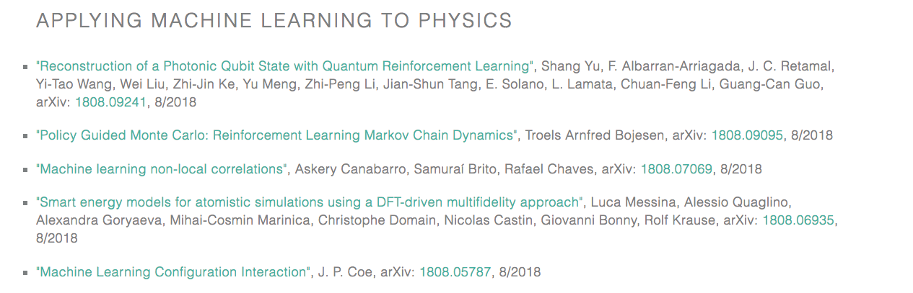
PHYSICS
https://physicsml.github.io/pages/papers.html

Slide 14

MUSIC
https://magenta.tensorflow.org/

Slide 15
AN ENDLESS LIST …
VIRTUAL ASSISTANT
AUTONOMOUS VEHICLES
…

Slide 16
EXAMPLES OF AI APPLICATIONS
IN AFRICA?

Slide 17
BY SECTORS
BANKING: M-Pesa (Kenya, Tanzania, SA),
LOGISTICS: Zipline (Rwanda, Tanzania, Ghana)
AGRICULTURE: Traceability, Twiga, Aerobotics (SA, Malawi, Zimbabwe), …
HEALTH: Sophia Genetics (Morocco, Cameroon)
…
Notes:
Konza Technology City, Kenya (Smart City, …)
https://www.mpesa.in/portal/
https://twiga.ke/twiga-story/
https://www.sophiagenetics.com
https://about.aerobotics.io/
http://frequentz.com/4319/traceability-brings-more-profits-and-more-stability-to-coffee-growers/
http://www.flyzipline.com/

Slide 18
AI NUTS AND BOLTS DEMYSTIFIED

Slide 19
AI & DEEP LEARNING IS MIMICING WORKING OF THE HUMAN BRAIN?

Slide 20
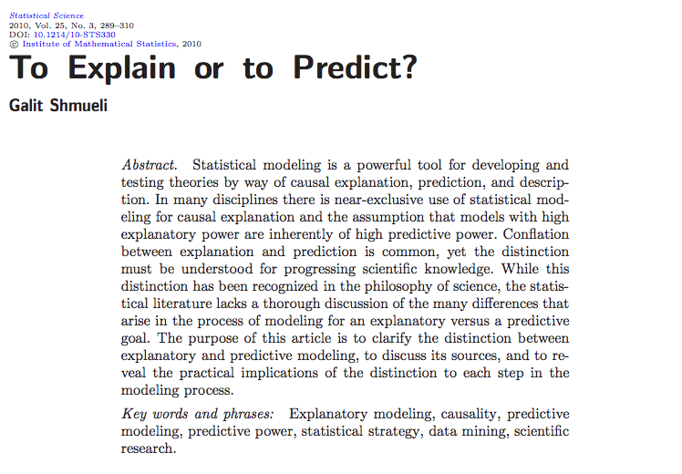
CLASSICAL STATISTICS MINDSET
ASSUME THAT MODELS WITH HIGH EXPLANATORY POWER ARE INHERENTLY OF HIGH PREDICTIVE POWER
https://arxiv.org/pdf/1101.0891.pdf

Slide 21

MACHINE LEARNING MINDSET
FOCUS IS GIVEN ON PREDICTIVE POWER BASED ON MONITORED/CHOSEN EVALUATION METRICS

Slide 22
PATTERN MATCHING MACHINE

Slide 23
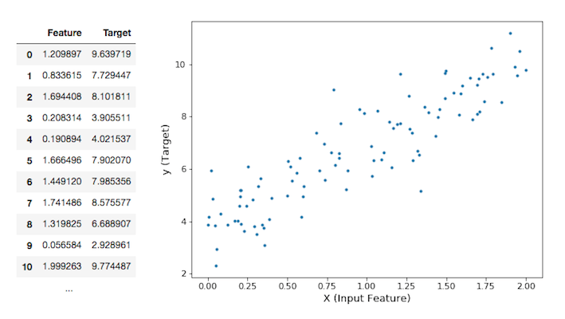
IS THERE ANY PATTERN IN YOUR DATA?
Notes:
Ex: soil moisture (target) given temperature, distance from river, ... (features)

Slide 24
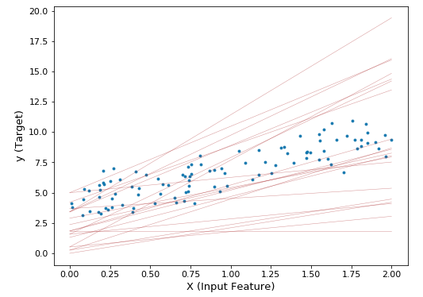
BUT WHICH LINE?

Slide 25
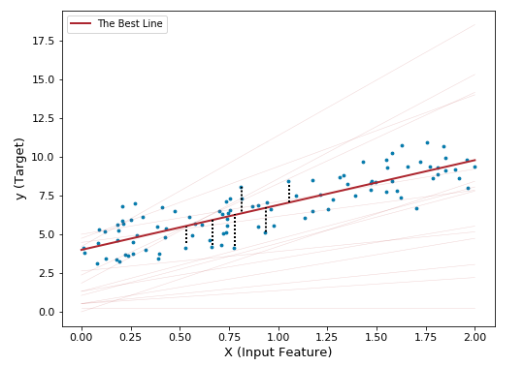
DEFINE AN EVALUATION METRIC?

Slide 26
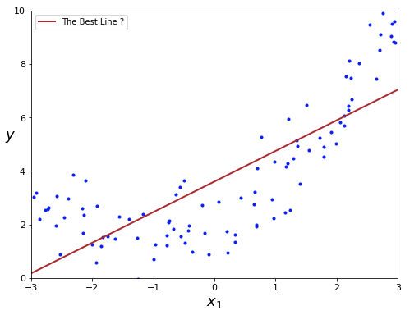
BUT NOW WHICH BEST LINE?

Slide 27
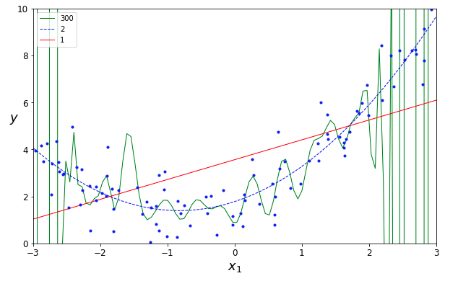
MODEL CAPACITY: WHICH ONE IS BEST?

Slide 28
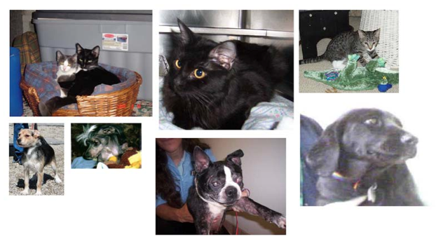
DEEP LEARNING AND CLASSIFICATION

Slide 29
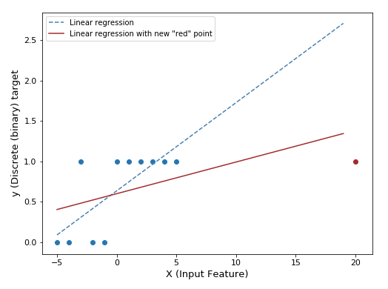
LOGISTIC REGRESSION 1/4

Slide 30
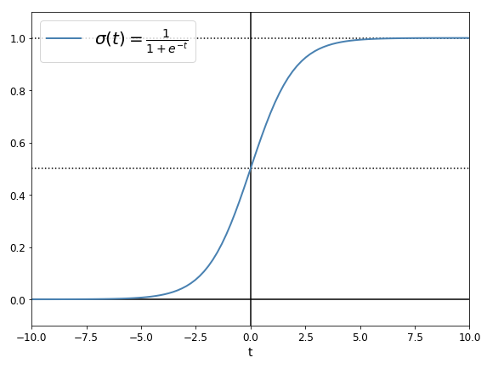
LOGISTIC REGRESSION 2/4: ACTIVATION FUNCTION
Notes:
This is named the activation function

Slide 31
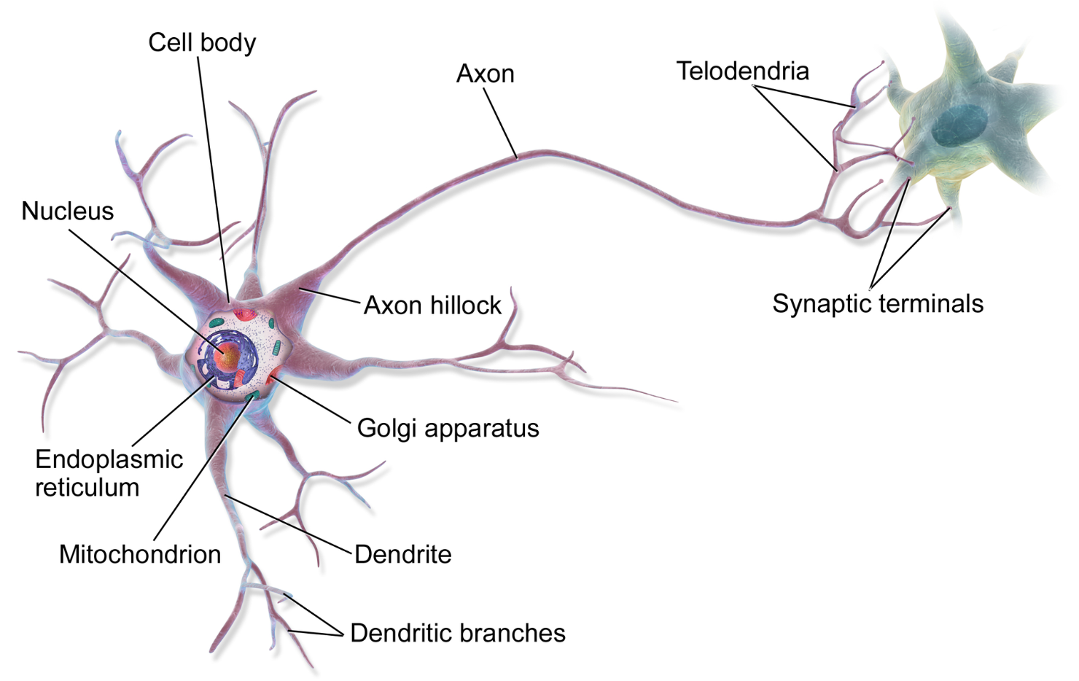
BIOLOGICAL NEURON
https://en.wikipedia.org/wiki/Neuron#/media/File:Blausen_0657_MultipolarNeuron.png
Notes:
Action potential

Slide 32
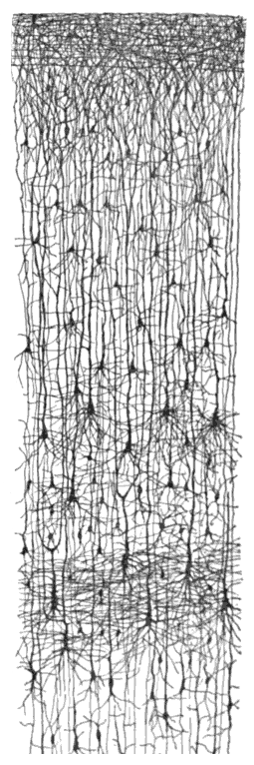
MULTIPLE LAYERS IN BIOLOGICAL NEURON NETWORK
https://en.wikipedia.org/wiki/Cerebral_cortex

Slide 33
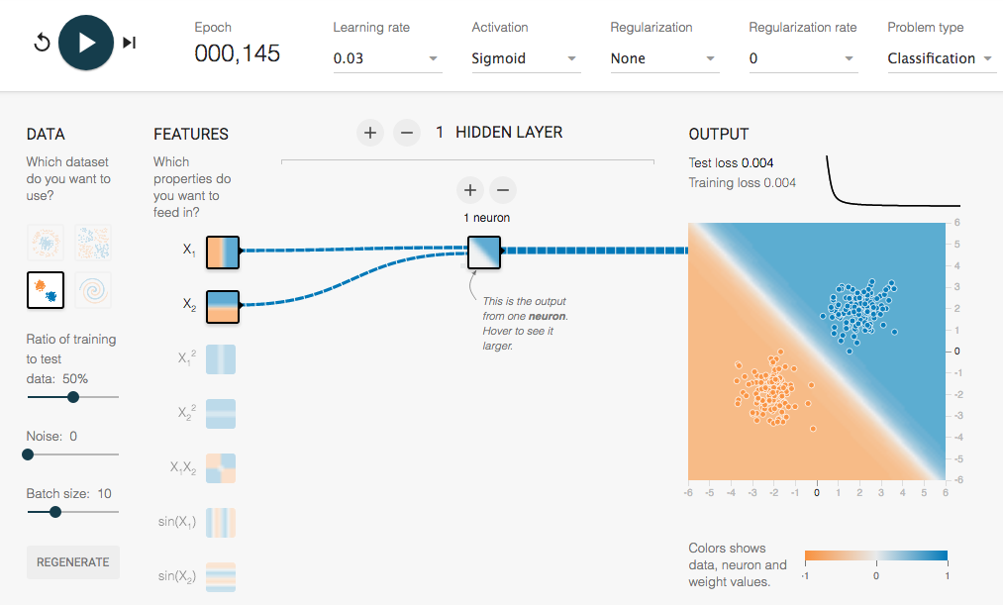
LOGISTIC REGRESSION 3/4: AT CRUISING SPEED
http://playground.tensorflow.org/
https://goo.gl/d5wwH3

Slide 34
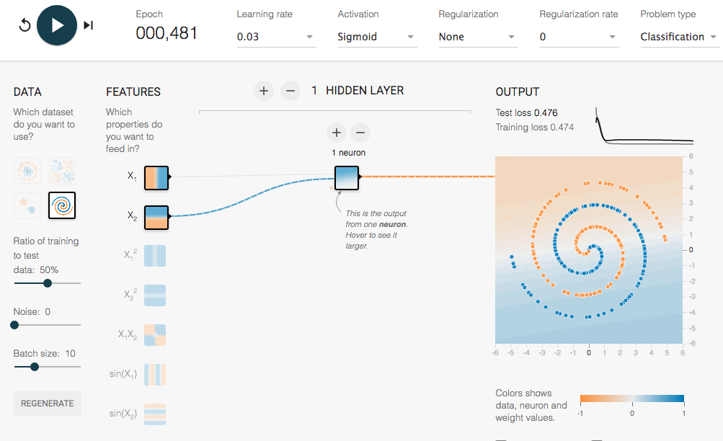
LOGISTIC REGRESSION 4/4: IN TROUBLE

Slide 35
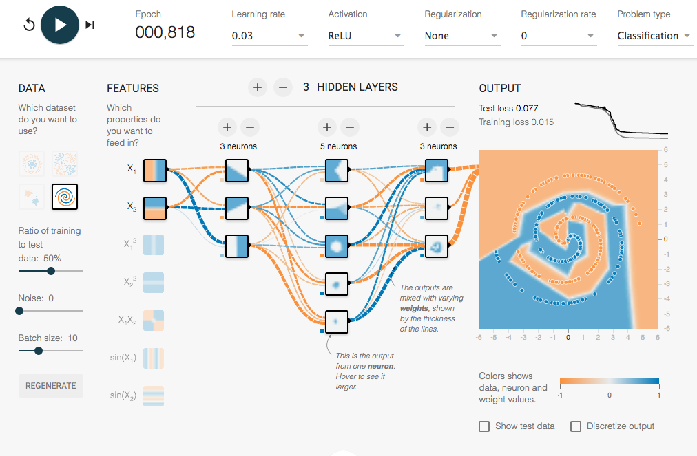
NEURAL NET COMES ON STAGE
https://goo.gl/ngcvpV

Slide 36
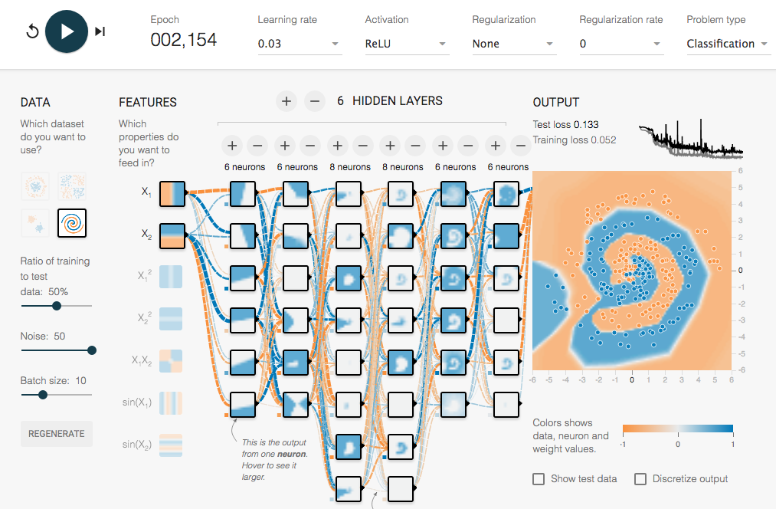
A “DEEP” NEURAL NET COMES ON STAGE
https://goo.gl/6BJ83E

Slide 37
A “DEEP” NEURAL NET COMES ON STAGE
https://goo.gl/6BJ83E

Slide 38
FINETUNE YOUR “MOULD”
OVERFITTING AND UNDERFITTING

Slide 39
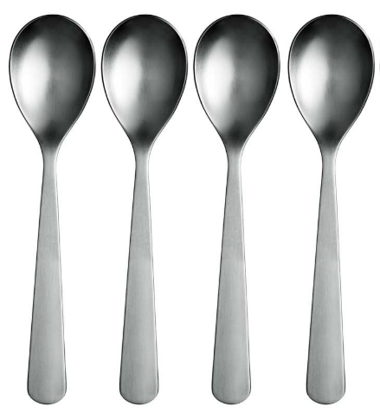
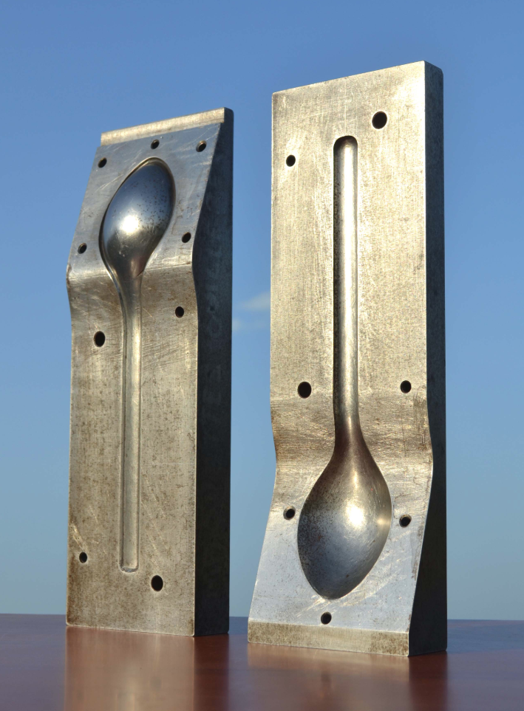
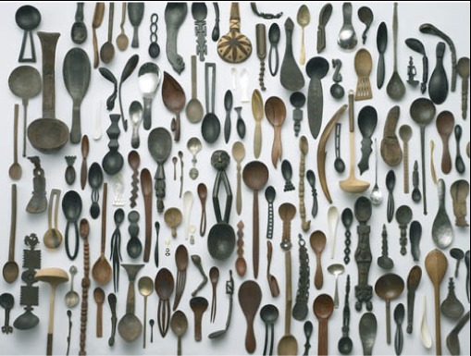
RIGHT DATA & RIGHT MODEL CAPACITY
TRAINING DATASET
MODEL “MOULD”
TEST DATASET
https://goo.gl/i2RCXF
http://www.20th.ch/antiquites_industrielles_objets.htm
PHOTO BY KENICHI HIGASHI
Notes:
Use modelling clay image

Slide 40
UNIVERSAL WORKFLOW ON DEEP LEARNING
DEFINE THE PROBLEM AND ASSEMBLE A DATASET
CHOOSE A MEASURE OF SUCCESS & DECIDE ON AN EVALUATION PROTOCOL
PREPARE DATA
DEVELOP A MODEL THAT DOES BETTER THAN A BASELINE
TWEAK CAPACITY BY TUNING YOUR HYPERPARAMETERS
Notes:
Use modelling clay image

Slide 41
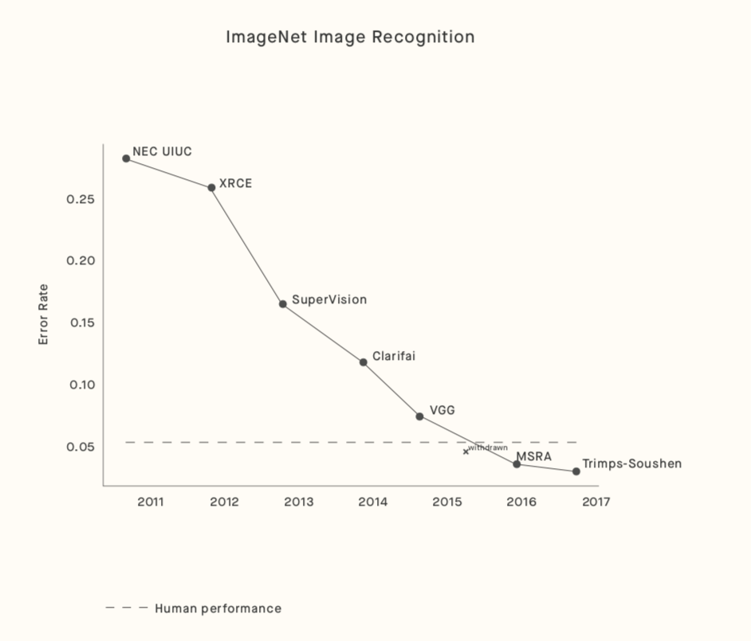
AI VS. HUMAN
DEEP LEARNING > HUMAN-LEVEL PERFORMANCE
BUT IN PARTICULAR DOMAINS (IMAGE RECOGNITION, …)
BUT ON VERY SPECIFIC/NARROW TASKS [FOR NOW]
https://arxiv.org/pdf/1802.07228.pdf
http://www.image-net.org/
Notes:
To be discussed in further session
We started with 2 parameters. State-of-the-art is hundreds of millions of parameters

Slide 42
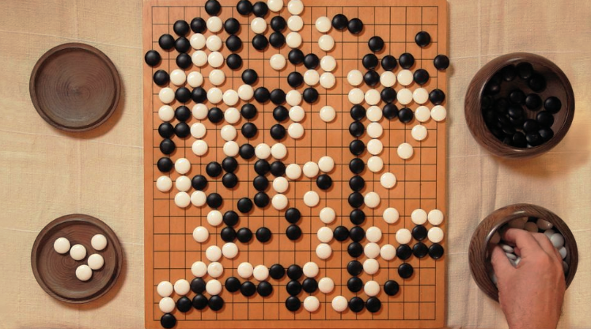
REINFORCEMENT LEARNING
IN THE SPOTLIGHT
FORTHCOMING DEMO IN SESSION 10 …

